Slide 1
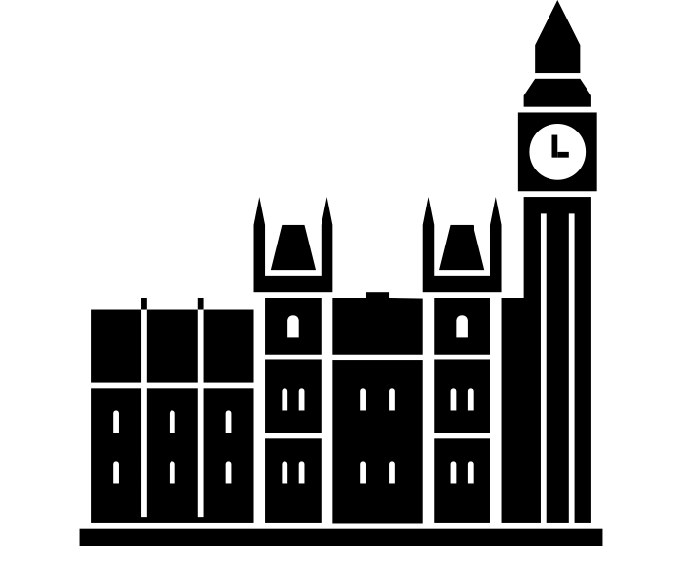
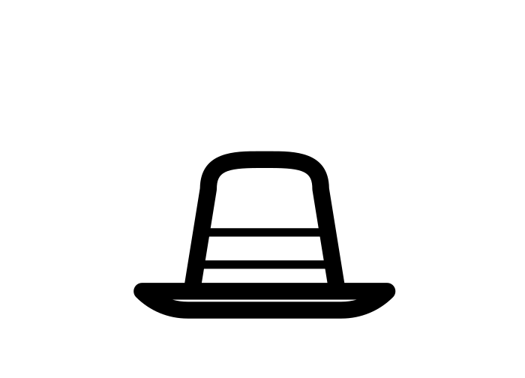
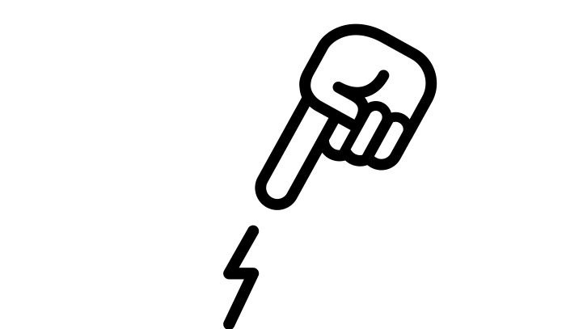
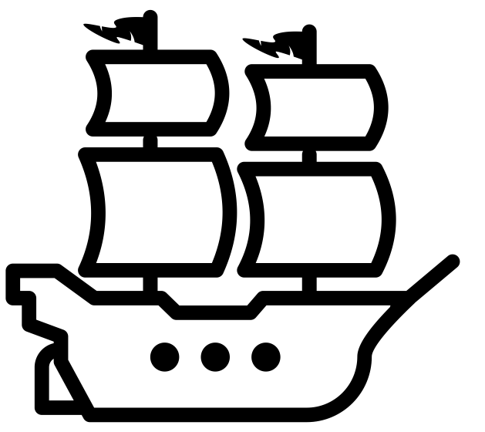
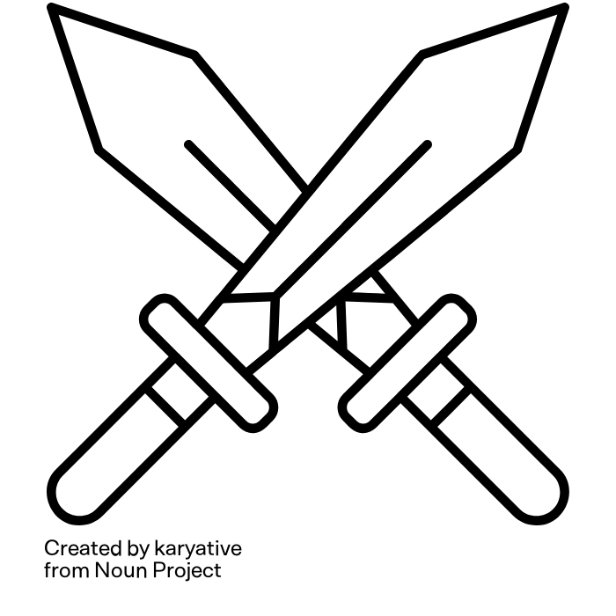
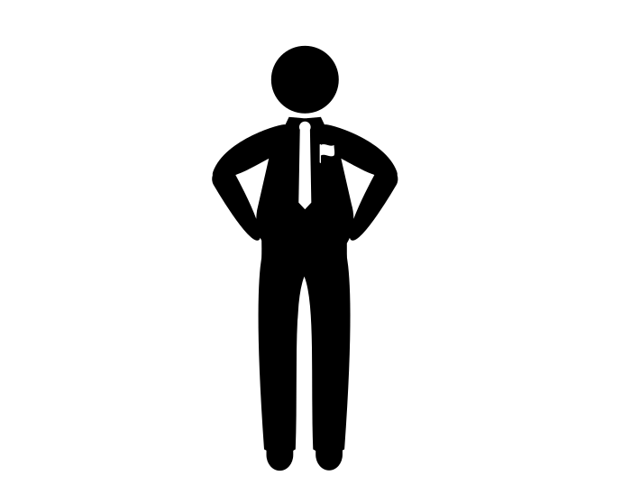
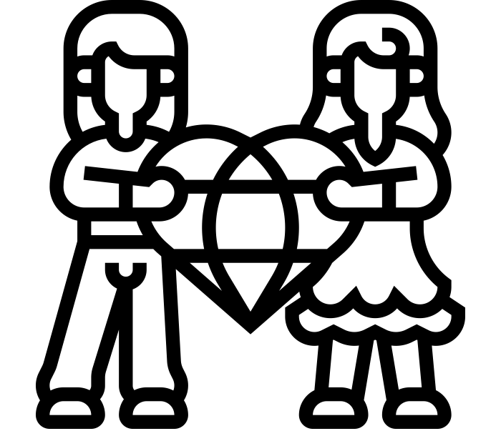
Explain how Parliament’s power changed between 1600 and 1700
1625 King Charles I comes to the throne.
1642 The English Civil war started.
1645
The Battle of Naesby victory for Parliament
1648 Charles I was found guilty of high treason
1649 Charles I was publically executed.
1653 Oliver Cromwell ruled Britain.
1658 Cromwell died.
1660 Charles II came to the throne.
Icon | Key Word | Definition
 | Parliament | A body which makes laws and runs the country.
 | Puritan | A very strict Protestant
 | Royalist | Supporter of the King
 | Divine Rights of Kings | The belief that the King is chosen by God to rule and can do no wrong
 | Ship money | unpopular tax that Charles forced people who lived near the coast to pay
 | Civil War | A war between the citizens of the same country
 | MP | Member of Parliament – elected to the House of Commons and be involved in ruling the country
 | Republic | A country ruled by an appointed or elected leader, not a monarchy.
 | Commonwealth | Government that aims to be for the good of everyone.
 | Restoration | The return of the monarchy in 1660
“Charles created opposition on too many fronts at the same time, and his policies had the tendency to unite his critics in a common cause. Not everyone disliked all of his policies, but he ended up upsetting a whole range of people for different reasons – and, crucially, he alienated the middle ground, as well as extremists.”
Professor Tim Harris
Knowledge Milestones | Extra Knowledge | Expert Knowledge
In 1625 Charles I became King of England. He was part of the Stuart dynasty | Charles, I took over a Protestant country deeply divided over religion between Catholics and extreme Protestants or Puritans | Charles I’s religion made some suspect he was a secret Catholic himself. Charles French wife Henrietta Maria was a Catholic.
The King and Parliament went to war in 1642 over money religion & power | Charles believed in the Divine Right of Kings, however Parliament believed he should share power with them = conflict | Charles continued to anger Parliament by ruling without them and raising illegal takes. When he sent soldiers to arrest 5 M.P’s Parliament declared war
The King was defeated by Parliament and put on trial for treason | During his trial, King Charles refused to co-operate or recognise the court’s right to try him for treason. | 30th January 1649 King Charles was executed. Parliament abolished the monarchy declaring England a Commonwealth
Parliament ruled England as a republic, however it achieved very little and became unpopular. | 1649, following an uprising in Ireland, Cromwell took an army of 12,000 men to Ireland. At the town of Drogheda his army massacred 3,000 Irish | 1653 Parliament appointed Cromwell Lord Protector, but he could not agree with Parliament and dismissed them. Instead, ruling England as a military dictatorship
Historians have different opinions about Oliver Cromwell’s rule | In 1649, following an uprising in Ireland, Cromwell took an army of 12,000 men to Ireland. At the town of Drogheda his army massacred 3,000 Irish | Upon his death, Cromwell’s son was appointed Lord Protector. However, his rule was unsuccessful and short-lived. In 1660 the monarchy was restored, and Charles II became King. This is called the Restoration.
In the 17th century there was a witch craze in England and Scotland | Hundreds of witches were tried, tortured and executed. Most of them were women, often old and poor. Two (fairly) local examples are Temperance Floyd and Elizabeth Castle | In unsettled times, fear of witches grew. This occurred during the Civil War and during the Puritan rule that followed it. Puritans had migrated to America and took their fear of witchcraft with them. The Salem witch trials occurred in 1692-3
READ
WATCH
LISTEN
If you want to find out more check out the following links or scan the QR codes on your phone or tablet.
https://www.historyextra.com/period/stuart/has-history-been-unfair-to-charles-i/
https://www.youtube.com/watch?v=bqi0Wd68Mio
Cromwell and the Protectorate–The Rest Is History – Apple Podcasts

