Slide 1
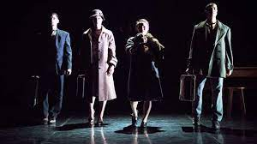
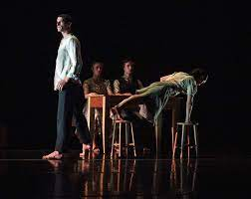
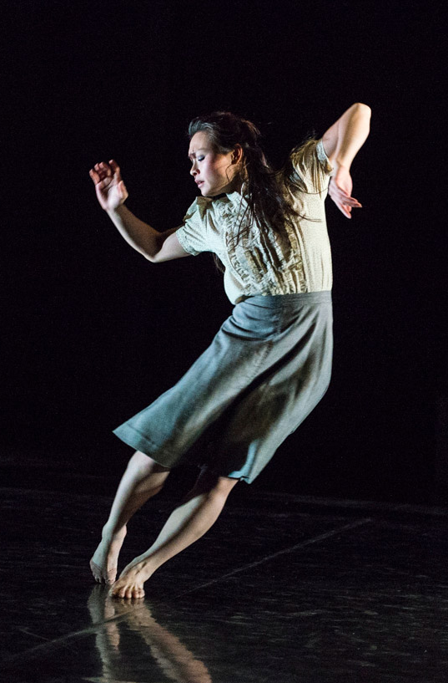
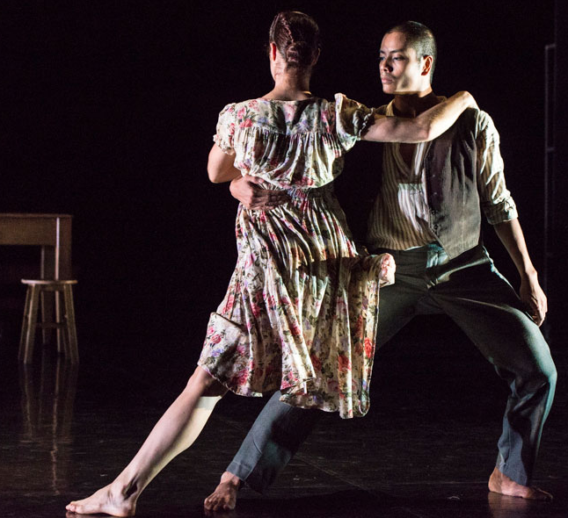
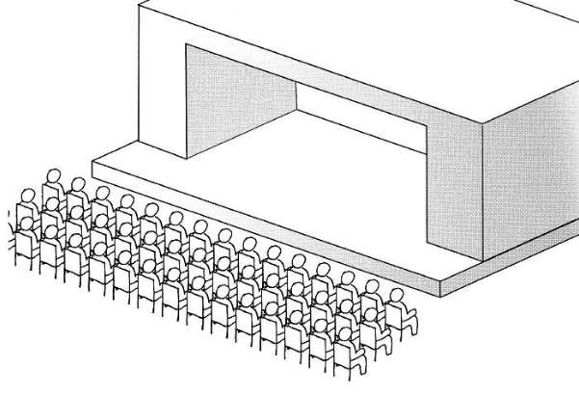
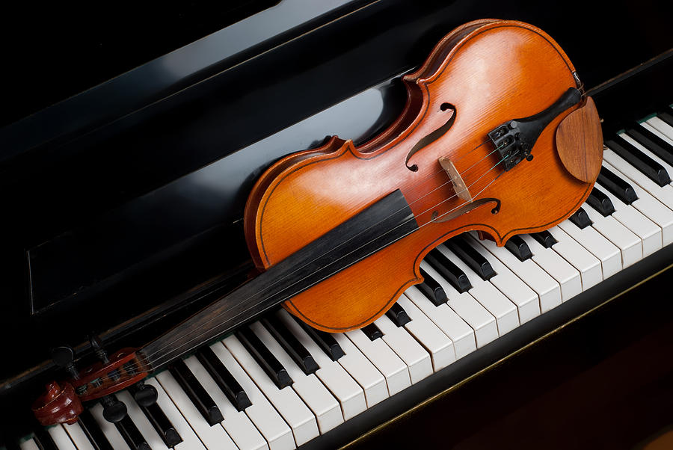
Shadows (2014) by Christopher Bruce: Shadows Video
Stimulus = the music: Fratres for violin & piano by Arvo Part. The relationships between family members as they deal with the fear of an outside force.
Choreographic Intention = A small family, possibly Eastern European, facing deprivation and the fear of what lies outside their home.
Bruce has stated that the Holocaust could be the source for the work with a family waiting to be taken to a concentration camp. However the story and setting is open to interpretation.
Ending: Whole family put on oversized coats & shoes, pick up suitcases and slowly look towards the audience as the lights fade.
Opening: Family at the table, restricted in a square of light. Slowly look towards the light.
Dance Style
Neo- classical
(contemporary, with balletic vocabulary)
Lighting and Interpretations
Diagonal white side light coming from downstage right = a looming threat from outside the room they are trapped in. Possibly Nazi soldiers.
Restricted square of light over the table = shows the family are trapped in a small space (similar to Anne Frank)
Brighter white light in Son's Solo = panic, lights shining to interrogate the family.
Lights fading to black out at the end = a sinister ending. The family possibly taken to a concentration camp.
Structure:
Semi-narrative
Section 1:
Daughter's Solo. Fast, panicked. Swift changes of directions
Section 2: Mother, Daughter & Father. Cradling, piggyback, tense, reassuring
Section 5a: Whole family return to the table and turn to focus on the light d/s/r - foreshadowing what comes next.
Key Actions and Interpretations:
Looking towards the light d/s/r = scared of the threat outside
Touching the shoulder = family – caring – reassuring
Mother folding actions = self-comforting, keeping her fears inside
Mother lying on the table = possibly gave birth in the room – memories
Piggy back carry son and daughter = playful, typical family lift
Mother and father dancing 'in hold' = memories of happier times
Son barricading the room with the table and stools = wanting to protect
Son's clenched fists = frustration, panic, anger at their situation
The family putting on coats and shoes = preparing to face their fate
The family walking forwards as the lights fade to black out = a dark,
sinister ending
Performance
Environment: End Stage
Section 4: Whole family dance in duets (son and daughter, mother and father). Development of the piggy-back, tender, sense of togetherness.
Son's Solo: Clenched fists, protecting the family, frustrated, angry, moves the table, stools to block the threat. Father approaches and reassures son.
Section 3: Mother and Father's duet. Affectionate, tender, recalling happier times.
Costume Descriptions
Mother: floral 1940’s tea dress, pink flowers, short puffed sleeves, calf length flared skirt, fitted waist, hair in bun
Father: collarless cotton white shirt with faint stripes, rolled up sleeves, grey trousers, brown waistcoat
Son: collarless white shirt, untucked, buttons undone at top, rolled up sleeves, grey trousers.
Daughter: delicate pastel cotton blouse, puffed short sleeves, pleat ed front, grey below the knee A line skirt, hair in ponytail
At the end: The Mother helps the children put on oversized coats and shoes as the leave the sanctuary of the room.
Costume Intentions
The era of 1930s/1940s
The family are living in poverty as the clothes are hand-me-downs and oversized
Their identity in the family is made clear: son, brother, daughter, mother
Props and Interpretations
A table, 2 stools, a bench, hat stand, suitcases = the family are in a
simple room, living in poverty as the furniture is basic. They pack their belongings into a suitcase as they leave
Aural Setting & Interpretations
Fratres by Avro Part: Violin and piano – melancholy mood
Faster tempo sections = panic and frustration (Son's Solo)
Repeated low piano notes = signify a change of section and sinister, dark threat
Higher notes = panic and a reference to happier times

Slide 2
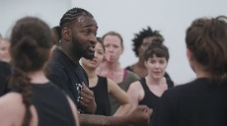
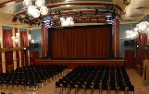
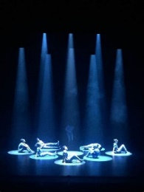
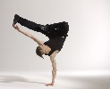
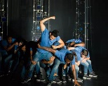
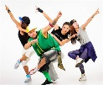
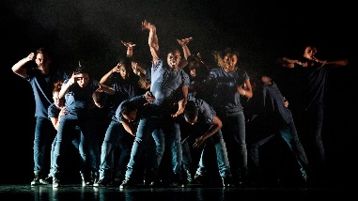
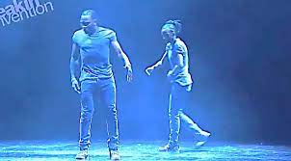
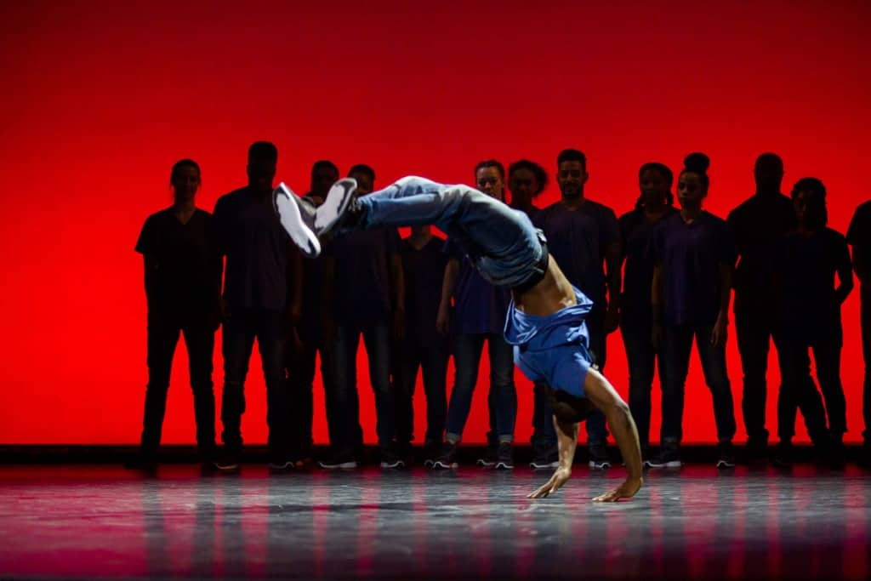
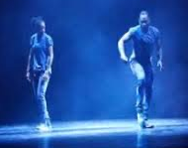
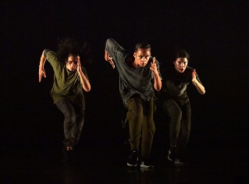
Dance Style:
Hip Hop
Waacking, Krumping, locking, popping, breaking
Emancipation of Expressionism (2013) by Boy Blue: Emancipation of Expressionism Video
WHAT THE TITLE MEANS: Emancipation = to be set free Expressionism = to express your feelings so… being free to express yourself!
Stimulus: The music ‘Til Enda’ by Olafar Arnolds fuses classical and Hip Hop music, which inspired Kenrick Sandy MBE to make a dance with his company Boy Blue www.boyblue.co.uk that enabled the dancers to be free to express themselves through Hip Hop movement. Hip hop originated on the streets, so was rarely performed in theatres!
Choreographic Intention = An emotional journey from the ‘birth of hip hop’ to being empowered to express themselves.
He also creates moments of chaos and order as the dancers are set free to express themselves through hip hop in a theatrical setting.
Krumping Take a look: Krumping Example
Waacking Take a look: Waakcing Example
Locking Take a look: Locking Example
Breaking Take a look: Break Dance Example
Popping Take a look: Popping Example
Lighting and Interpretations
Genesis:
Spot lights around the soloists creates a womb-like environment
linking to the birth of hip hop.
Smoke Haze suggests being on the streets, where hip hop originated
Blue: represents their dance company ‘Boy Blue’ and pride in their dance company
Growth and Struggle
White side light moving into the light / going against the crowd
Connection and Flow
Blue with a white pool of light over the duet focuses the
audience on the duet
Empowerment
Cyclorama (back drop) changes colour to purple/red celebrating the empowerment of hip hop.
Brighter lights provide a hopeful mood and atmosphere
Structure:
Episodic
A,B,C,D
Performance Environment:
Proscenium Arch Stage
Which is significant because
a proscenium arch stage is a
traditional stage, where ballet
is usually performed. Therefore giving hip hop a similar status to ballet!
Ending: Darkness –
2. Growth and Struggle: The struggle to bring hip hop from the streets to the theatre. ‘Going against the crowd’ (Krumping in the rugby scrum). Solo dancer dances into a crowd and towards the side lights. Hip hop music (lyrics “I feel you’re the one”) Action and reaction – taking people with you as hip hop develops. Section of chaos convey the chaos and order intention in the dance.
3. Connection and Flow: Kenrick and the female dancer perform an action and reaction duet using popping and locking to classical music. They pass a ball of energy between them. This could link to the teaching of hip hop to others. The classical music gives hip hop the same status as ballet,.
4 Empowerment: The dancers are finally free to express themselves through hip hop. Each dancer has a solo in each hip hop style. The Ninja Walk motif is developed using pathways and embellishment (adding a head roll). Music: Til Enda by Olafar Arnolds fuses hip hop and classical, to show both styles are as important as each other.
Genesis: The birth of hip hop. Action and reaction. Individual dancers have solos. Circular lights convey a ‘womb-like’ environment. Hip hop music (lyrics “let the beat drop”. Introduction of the Ninja Walk motif.
Key Actions and Interpretations:
Ninja Walk Motif: shows the urgency to express themselves through hip hop – developed as Ninja Slide, Ninja Static, adding head rolls, changing pathways, formations and directions
Costume
Choreographic Approach
How the piece was made in the studio
Choreographer Kenrick Sandy worked closely with the aural setting, paying particular attention to musicality. Whilst the choreographer and the dancers selects certain movements and ‘signature’ motifs (Ninja Walk, Ninja Glide, Ninja Static), and applies choreographic devices (directions, pathways, embellishment), formations and use of space.
Aural Setting & Interpretations
Reflects an emotional journey
Genesis: Urban, hip hop music closely connected to the dynamics in the movement.
Lyrics ‘Let the beat drop’. Fast, tense, mood electronic music.
Growth and Struggle: Urban, hip hop music creates an urgent atmosphere in the struggle for hip hop to be accepted. Lyrics “I feel you’re the one” – as the soloist pulls the other dancers along with him.
Connection and Flow: Classical music by Max Richter softer mood, as Kenrick ‘passes’ his passion for dance to the female dancer. Classical music shows that hip hop is just as important as classical.
Empowerment: Til Enda by Olafar Arnolds this was the stimulus for the dance. The blend of urban, hip hop music and classical strings, suggests that classical and street / hip hop can coexist on the stage and have equal status.

Slide 3
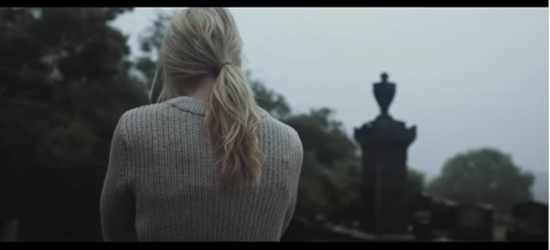
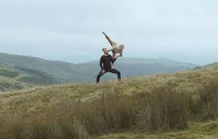
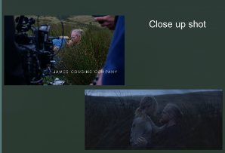
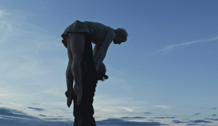
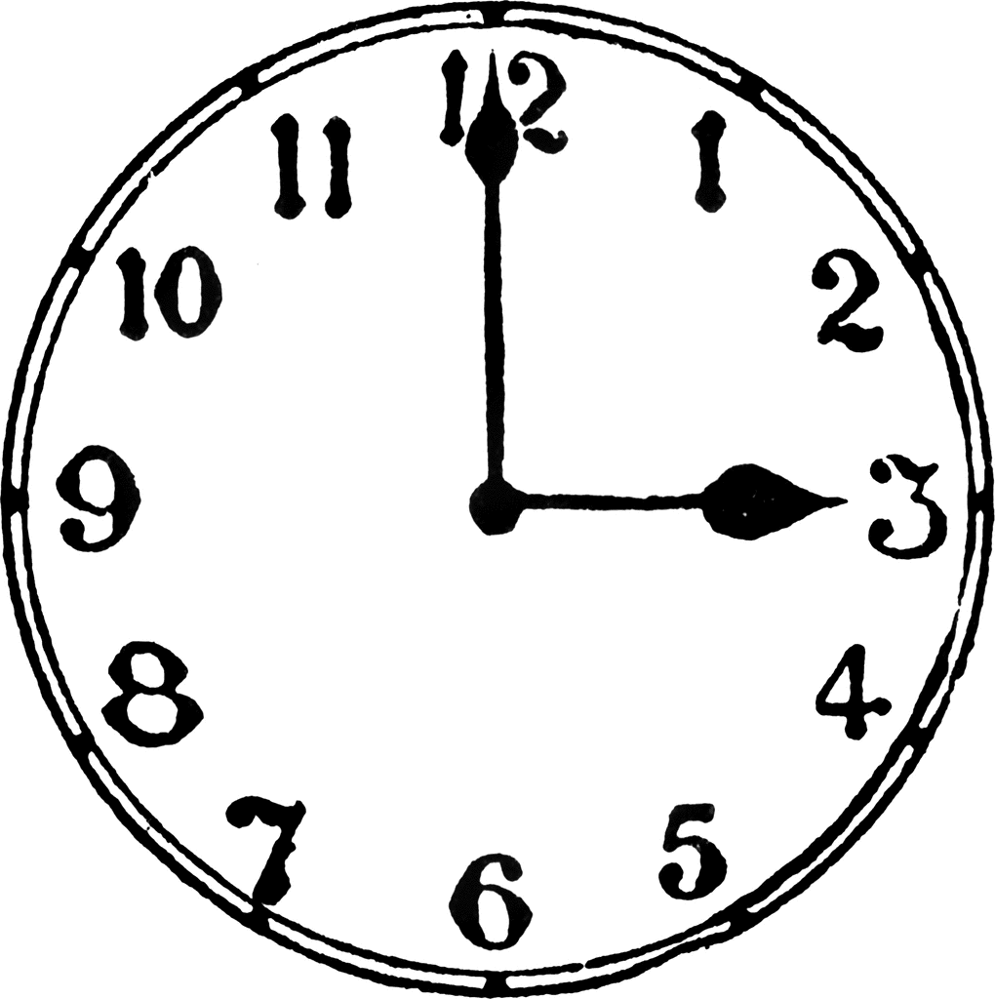
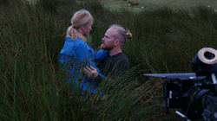
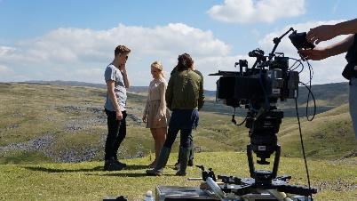
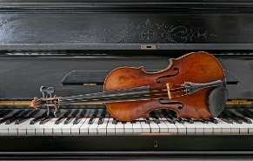
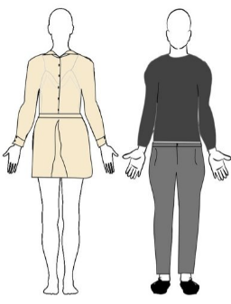
Dance Style
Contact work, created through improvisation, keeping the female dancer off the ground.
Within Her Eyes (2016) by James Cousins: WITHIN HER EYES VIDEO
Stimulus A love story with a twist! A story of love, loss, guilt, dependency and loyalty, longing and memory.
Ultimately, the couple can never be together.
Choreographic Intention = Grief. The female dancer is grieving for a lost love and struggles to accept the new man in her life. She reaches, wraps, balances and falls on the male dancer, who is there to support her every move. He responds to her needs. They do not make eye contact until after the Forest scene, when she starts to accept him. He does not let her touch the floor, which is a metaphor for the fact he will never ‘let her down’.
1. Prologue: Female dancer walks through the streets and a graveyard. Grief is shown as she performs self comforting actions – strokes her hair. Follow shot could suggest she is being watched by her lost love.
Performance Environment:
Site Sensitive and Dance for Camera
Filmed on location in Wales
Lighting and Interpretations
Natural Lighting = shows the passing of time from the morning to the evening of their relationship.
Prologue: Early morning low light = shows the female dancer walking through the streets and a graveyard. This is the start of her journey through grief
Brighter light on hill top = the start of the male and female dancer’s relationship – could convey hope.
Grey Clouds = looming threat. Dark days of grief and sadness.
Openings in the clouds = Heavenly connection – nearer to her lost love
Sun coming through the trees in Forest = the afternoon of their relationship, the spirit of her lost love.
Sun setting as they sit in the long grass = the sun setting on their relationship
Darkness in the Quarry section Their relationship is ending – they are ‘on the rocks’
Camera Shots
2. Hill Top: Female dancer does not make eye contact. She initiatives all movements (reaching, arching, twisting, falling), he supports her. Long shot suggests they are not yet close. She reaches away struggling to accept him.
Ending: Darkness –
the end of their relationship.
Structure:
Semi-narrative
3. Forest: More intimate actions, the couple are getting closer. Mid – long shots through the trees suggest they are being watched. She still has not touched the floor
5. Quarry & Hill Top: Faster section. Their relationship is becoming rocky. He elevates her to be nearer to ‘heaven’. The light is dark, symbolizing the ending of their relationship. Fast edits = arguments. Dynamics are sharper, she resists, uses flexion and tension.
Key Actions and Interpretations:
She does not make eye contact with him = struggles to accept him
She does not touch the floor until the long grass = he supports her completely
She initiates all the movement = allowing her to heal at her own pace
Reaching, arching, twisting, falling, elevated, extending = female dancer
resisting the male dancer’s support. Trying to get back to her lost love.
Supporting, grounded, cradling, guiding, lifting = the male dancer
providing emotional support, guidance, reliability and loyalty
4 Long Grass: She finally touches the floor and makes eye contact with him. Their gestures are more intimate – she continues to initiate all movement. Close up shot suggests she finally accepts him!
Costume Descriptions & Interpretations
Costumes are stylised everyday clothes.
Female Dancer: wears a beige shirt and skirt and bare feet
Male Dancer: wears a khaki jumper and jeans with shoes
The darkness of his costume contrasted with the lightness of hers adds to the illusion of her just floating on him in the space. The darkness of his costume links him to the earth whereas the lightness of her costume gives her a more ethereal (angelic) and celestial feel.
Aural Setting & Interpretations
Created specifically for the dance
Haunting sounds of electronic strings
and piano = melancholy mood - grief
Wind sounds = pathetic fallacy – supports the site sensitive setting and creates tension
Higher notes = Links to the female dancer
Lower notes = link to the male dancer
Slower tempo = Long grass more harmonious relationship
Faster tempo = Quarry section – arguing, tension
Settings / locations / Camera Shots and Interpretations
Prologue: Graveyard and Street Follow Shot = Spirit of her lost love following her
Hill top Long Shot / Wide angle = the male and female are not close yet. There is distance between them
Forest Mid shots, Shots through the trees = they are getting closer, voyeuristic shots possibly watched by the spirit of her lost love.
Long grass Close up shot = they finally make eye contact and are intimate
Quarry Fast edits, long, mid and close up shots = frantic arguing, their relationship is falling apart, they are ‘on the rocks’ – the story ends in disaster with her legs hanging at the end

Slide 4
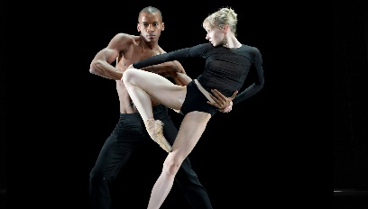
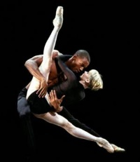
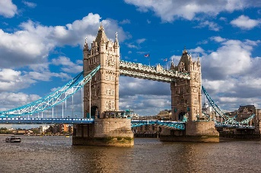
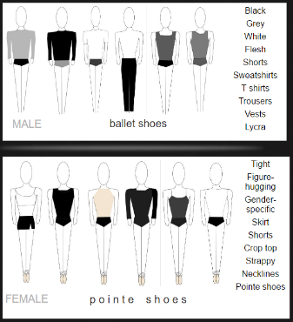
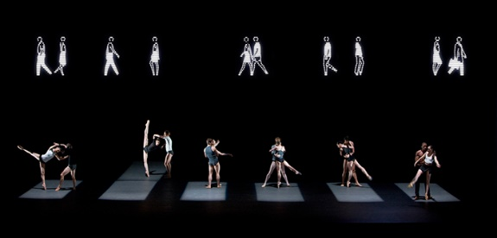
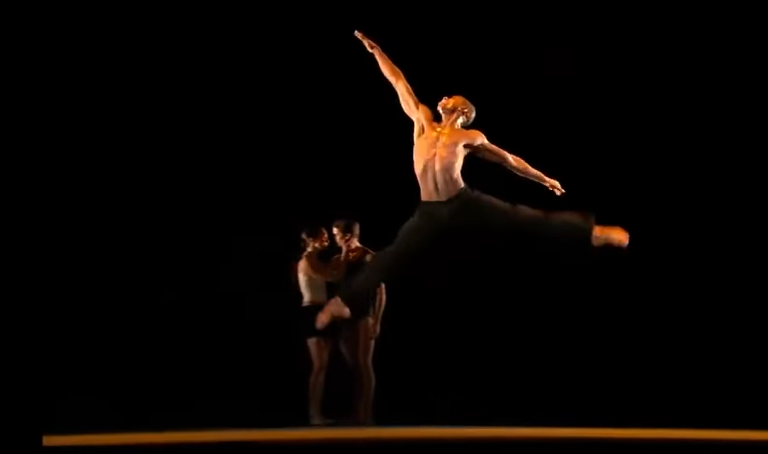
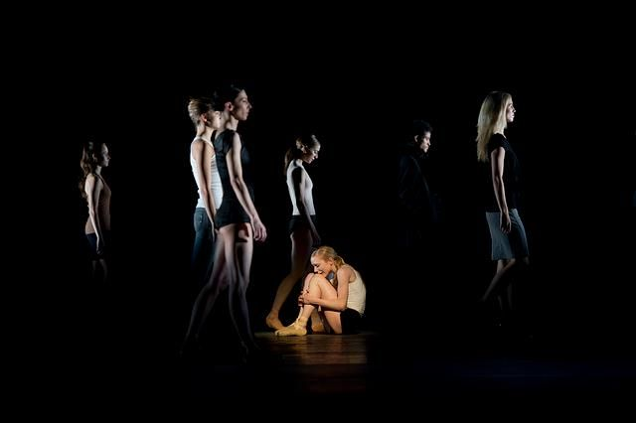
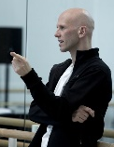
Dance Style: Contemporary Ballet
McGregor’s dance style is distinctive for its speed, energy and for the dynamic, angular, sinuous and hyperextended movements that push dancers to physical extremes.
Infra (2008) by Wayne McGregor. Performed by The Royal Ballet: Infra Video
Stimulus : The title Infra comes from the Latin word for 'below' and the work presents a portrait of life beneath the surface of the city of London.
Choreographic Intention = This abstract ballet delves beneath the surface to present human interactions and inferences between the community in London in the aftermath of the London 7/7 bombings. Wayne McGregor was also inspired by the poem The Wastland by TS Eliot – specifically the line: “Under the brown fog of a winter dawn. / A crowd flowed over London Bridge’.
Structure:
Episodic
with solos, duets and ensemble sections
Performance Environment:
Proscenium Arch Stage
Traditional theatrical stage,
Typically used for classical
ballets
London Bombings 7/7/2005
BBC News London Bombings 7/7/2005 – watch
The 7 July 2005 London bombings, were a series of
four co-ordinated suicide attacks carried out by
terrorists that targeted commuters travelling on London‘s transport network during the morning rush hour.
Sections for Study:
Key Actions and Interpretations:
Costume Descriptions & Interpretations
Fitted shorts, vests, t-shirts in flesh, black, white, grey colours for the dancers.
muted colours = link to the solemn mood and atmosphere.
Grey = smoke from the 7/7 London Bombings
Exposed limbs = show the dance style and hyperextension
The females wear pointe shoes = links to the style of contemporary ballet
Street clothes are worn for the brief appearance of the crowd = pedestrians, conveys the
‘Crowd flowing over London Bridge’ and complements the figures in Julian Opie’s led screen
Rectangles of Light:
Accumulation of fast, angular ‘pas de deux’ (male / female duets in contact). Hyperextension, expressive gestures and changes of focus in unison, canon and counterpointing the led figures, set within each rectangle of light.
= intimate conversations behind closed doors, ‘inferences’ between people affected by the bombings. Unison could suggest they feel the same. Audience see what ‘lies beneath’ their emotions.
2. Eric’s Solo:
Fluid body ripples, high leg extensions, back bends, changes of direction with an inward focus, performed downstage centre, counterpointing with the tender pedestrian duet upstage right.
= Eric’s inner feelings and emotions. Perhaps he lost someone in the bombings and the duet represent his memories of that person
3. Stranger in a Crowd:
Soloist breaks down centre stage with highly expressive facial expressions and pedestrian gestures, dropping to the floor. The rest of the company walk past her from stage right to stage left complementing the led figures.
= inner emotions come to the surface, we see the raw emotion and loss she feels
Lighting and Interpretations
Pools of light in white, amber and green downstage = lights the main action that is downstage , underneath the led screen
Rectangles of light = illuminated windows ‘looking in on peoples conversations’. Could also be a zebra crossing
Low intensity light = dark emotions, the darkness of the underground
Green pool of light = acrid, acidy toxic smoke of the bombings
Amber pool of light in Eric’s solo = recalling memories, softer tone.
White side lights in ‘Stranger in a Crowd’ = highlights their blank facial expressions in contrast to the spotlight on the central soloist who is highly expressive and crying.
Choreographic Approach: How the piece was made in the studio
McGregor uses three methods to generate movement vocabulary
SHOW a phrase to the whole or part of the cast – dancers watch and either recreate the phrase exactly or create a version.
MAKE a phrase on a target dancer or dancers – others watch and copy or develop.
TASK – set a choreographic task for dancers to complete or pose a choreographic problem for dancers to solve. Typically the task or problem involves imagery as a stimulus for creating movement.
The movement vocabulary is then structured into longer “sentences” and “paragraphs”. Finally he works musically with the structure and pieces it all together like a jigsaw
Setting
and Interpretations
Julian Opie’s 18m led screen of walking figures randomly programmed so it changes each night.
= represents the line from The Wasteland, ‘A crowd flowed over London Bridge’
= complements and contrasts the dancers actions
= the dancers perform underneath the led screen, linking to the intention of ‘beneath the surface’
Aural Setting & Interpretations
The score by Max Richter mixes melancholy string melodies = conveys the solemn mood
Electronic sounds such as train-whistles, alarms = the underground, aftermath of the 7/7 bombings
Moments of silence = how the bombings affected peoples ears / quiet moments of reflection

Slide 5
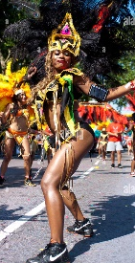
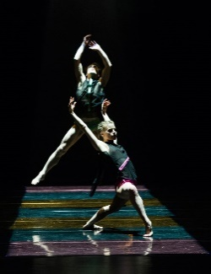
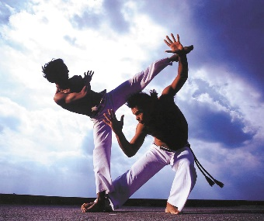
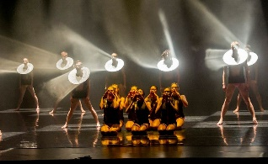
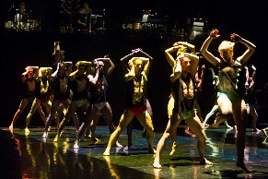
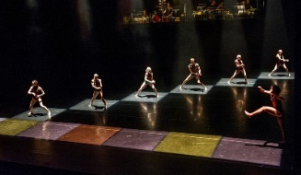
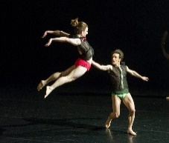
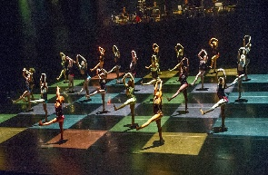
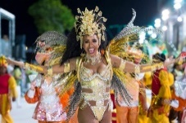
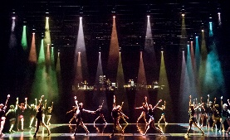
Dance Styles: rhythmic pulses fusing…
Brazilian Samba Contemporary BrazilianCapoeira
A Linha Curva by Itzik Galili, Performed by Rambert: A Linha Curva Video
Stimulus: = A Linha Curva means The Curved Line in Portuguese and links to the line of energy in a party (high energy, slow ‘Heat of Brazil’ section, returning to the energy of the party at the end). The stimulus for the work is Brazilian culture. Galili wanted to create a celebration the Brazilian way of life and the ability to live in the moment.
Choreographic Intention = simply to have fun - Large ensemble sections of vibrant Brazilian inspired movement are performed in regimental straight lines, (linear pathways) creating a sense of Brazilian carnival samba parade. There are also a number of narrative sections that through the choreography present observations of how Brazilian men communicate with women, for example men in tribes hunting the girls as well as showing off and competing with each other. The slow section references the heat of Brazil and sweat dripping off the dancers’ bodies.
Structure: Episodic:
Big ensemble sections include the chequer-board lighting. Other sections are more narrative (Men Showing Off & Heat of Brazil) and the lighting is different. The piece starts with call and response before an ensemble party section and ends with another party section, with one man shouting for the party to continue!
Performance Environment:
End Stage:
The musicians are visible on a raised platform upstage
Props
Can you spot the only props? There are 5 skateboards that are pushed from one side to the other with a dancer riding them on their backs – this simply communicates the sense of FUN!
Watch: Rio Carnival
Opening Section:
Call and response: The men call ‘doom be be’ and the women respond ‘eh eh eh’. Like a call to the party! The silver discs around the men’s necks reflect the light into the audience creating a ‘disco ball’ effect!
2. The Party / Carnival Starts:
Accumulation of more dancers onto the stage: All performing the Lyris and George motifs.
Fast arm gestures in linear formations representing the parade of a Brazilian carnival. Samba rhythms and bright chequer-board lighting
3. Heat of Brazil :
Tempo slows – marimba creates s sense of tension. Dancers perform slow ‘dropping’ actions with deep lunges in low-lit amber squares, suggesting the heat of the midday sun and everything slowing down – dripping with sweat as Brazil is so hot!
4. Men Showing Off:
The men show off with shouts and ‘cat calls’ to the women. Large jumps and capoeira style actions convey their masculinity and competitiveness between them.
5. The Party Starts Again!
Tempo increases –percussion 2/2 samba rhythms. Dances return to the stage in linear formations, repeating motifs from the opening section in the chequer-board lighting grid. Should shakes add excitement and anticipation. At the end, one male dancer continues jumping and shouting ‘Ay ya’ as he wants the party to continue!
Choreographic Approach
When originally creating A Linha Curva, Itzik Galili worked collaboratively with the dancers and nearly all of the motifs were composed from improvisation.
Galili asked the dancers to choreograph a very short solo motifs that represented the dancers’ personalities and stayed within the boundaries of their allocated square within a chequer-board lighting.
Each of these sequences was named after the dancer: (George, Lyris) who made it and the dancers then learnt each other’s sequences to form the basis of this large ensemble work.
Costume Descriptions & Interpretations
Aural Setting
& Interpretations
Live percussion played by ‘Percossa’, a percussion quartet on a raise platform upstage. Fun, party atmosphere – suggests a Brazilian carnival
Fast Samba rhythms: links to the Samba dance style and Brazilian culture of ‘living in the moment’.
Call and Response at the start: Men call the women to the party!
Men ‘cat calling’ the women: Showing off!
One man continues shouting at the end: He wants the party to continue.
Lighting and Interpretations
Chequer-board, multi coloured lighting, pre-programmed and changes in time with the music =
Bright colours & flashing lights = fun, living in the moment and Brazilian carnival. Highlights each dancer.
Low intensity, yellow light in the ‘Heat of Brazil’ section = heat of the midday sun
White pools of light in the ‘Men Showing Off’ sections = nightlife in Brazil, moonlight, street lights

Slide 6
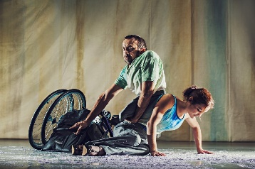
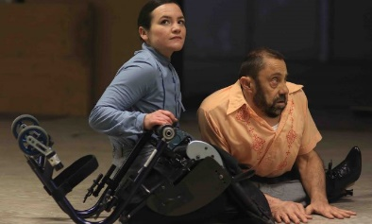
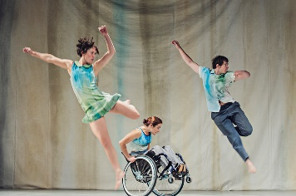
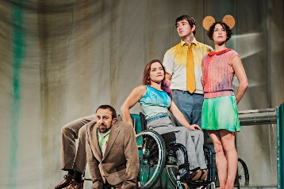
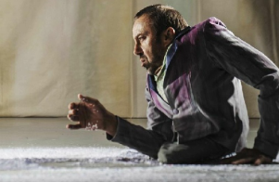
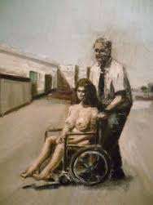
Dance Style:
Inclusive Contemporary Dance
Stopgap Dance Company include dancers who are both able-bodied and disabled.
Artificial Things (2014) by Stopgap Dance Company: Artificial Things Video
Stimulus = Lucy Bennett, the choreographer, was initially inspired by the isolated figures and settings of paintings by Goran Djurovic. You’ll see aspects of his paintings used as the props, costumes and choreography in Artificial Things. She also drew from the idea of a snow covered urban landscape ( a snow globe) and the dancer’s personal experiences of being disabled
Choreographic Intention = Coming to terms with life’s limitations, being the subject of the gaze of others (the dancers shared that they often felt people stare at them and cannot escape other people’s ‘gaze, saying it felt like being trapped in a snow globe, that anyone can pick up and ‘shake their world’ at any time.
Sections & Interpretations
Structure:
We study Scene 3 only
(you do not need to know what happened in Scene 1&2)
We join the dancers at the start of Scene 3 in the aftermath of a tragedy. We then see the dancers work together to resolve things.
1. Two Duets: Ground-based, caring contact duets. Inviting touch between Laura and Dave. Looked on by the two able-bodied dancers (Amy and David) this links to the intention of being the object of the gaze of others.
2. Reconstructing Laura’s wheelchair: The quartet work together to rebuild the wheelchair that had been broken in the previous scene during the ‘disaster’. This links to the intention of overcoming life’s limitations.
3. Travelling Trio: The trio of Amy, David and Laura begin to find harmony and overcome life’s limitations, whilst dancing with one another and Laura’s wheelchair. Following Laura’s lead they explore the movement of the chair, and each dancer takes responsibility for the wheelchair.
Laura’s motifs are developed by Amy and David, who travel alongside Laura, recreating her movements as closely as they can.
Amy repeats a ‘look’
over David’s shoulder,
As she holds his shoulders.
Replicating this image from
one of Djurovic’s paintings.
4. Family Portraits: The trio eventually gathers around David, who has been watching (object of gaze) from the vitrine (glass display cabinet), and they re-enact portraits of past family photos influenced by the paintings of Djurovic
5. The Sunshine of your Smile: David’s Solo: David leaves the group as the music ‘The Sunshine of Your Smile’ begins and finds a lonely spotlight. He dances a simple solo focusing on facial expression and physical storytelling to the song that his father used to sing when he was young . His father helped him overcome his limitations. This solo is a tribute to his father. He manipulates the snow-covered stage, enhancing the image of being trapped in a snow globe.
Hand shaking gestures, ‘wing-like’ arm gestures and laying playing cards feature throughout.
David returns to the group and is frozen in time with the other characters as the scene comes to a close.
Goran Djurovic Paintings
Costume Descriptions & Interpretations
The costumes are a wash of blue and green, merging with the backdrop. It looks as if paint is running from the garments, which is a reference to being stuck in one of the paintings by Djurovic. Outer garments worn in previous scenes, such as jackets and jumpers, are removed in this scene to depict that time has moved on. Dave’s brow jacket is open at the back to allow him to have freedom of movement. It matches the stuffed legs placed on the glass cabinet – when he sits atop of them, he appears ‘complete’ again – overcoming his limitations.
The costumes are gender-specific. Laura also wears high heels at one point. Murky browns also refer to Goran Djurovic’s paintings.
Staging, Set, Props & Interpretations
The set is influenced by several paintings by Goran Djurovic. Look out for similarities between features of the set and the pictures on the left.
It consists of a painted heavy backdrop of pastel coloured paint which looks as if it is running down the canvas. The snow filled glass cabinet is on its side with a snowdrift inside the cabinet – conveying the snow globe. Paper snow is scattered on the ground in a diagonal from the cabinet. In front of the cabinet there are two stools and a headless suit on mannequin legs perched on a third stool. The dance floor is a light grey and around the edge is a wooden frame reflecting the colour – trapping the dancers as if in a ‘snow globe’, or one of Djurovic’s paintings. This also shows the audience they are looking into the snow globe of artificial things.
Lighting and Interpretations
For much of the piece the lighting focuses in on one or two spotlights to highlight the dancers. It is dark, reflecting the sinister atmosphere at the start. The lighting brightens and opens out in the middle, with a blue wash and warm and cool side lighting for the more ‘hopeful travelling trio’ as they are more free.
A pool of light, similar to the Djurovic paintings, surrounds Dave in his solo, before being focused on the cabinet and stools in the final tableau of the family portrait at the end.
Choreographic
Approach
Choreographer Lucy Bennett uses a collaborative approach with the dancers who are encouraged to actively contribute to the process through choreographic tasks. Much of the material from scene three has been driven by Laura Jones’ movement in her wheelchair and has been translated by the standing dancers David and Amy.
Aural Setting & Interpretations
Andy Higgs used the whole of the piano - both inside and out showing that even though the piano is broken, it can still produce something beautiful and create a cold, ambient sound. He wanted to create a futuristic atmosphere acknowledging that time had passed and that the old ways had broken down. He also used the sound of the paper snow and incorporated other sound effects such as a distant rumble, wind and footsteps through snow. This supports the inhospitable environment the dancer find themselves in. The mood and tone lift in the travelling trio This shows they are happier and more free. Elements of the song ‘The Sunshine of Your Smile’ were mixed into the atmosphere often sounding distorted or as if drifting in on the wind. The final section uses the full version of the song, and is more uplifting, as Dave remembers his father.
Performance Environment:
Proscenium Arch Stage

